Slide 1

ADAM TRAINING GUIDE
Award Title | Expanding Efforts and Strategies to Improve Public Health in Kenya
Cooperative Agreement | NU2HGH000033-02-00
TA Project Title | Protecting and Improving Health Globally: Building and Strengthening Public Health Impact, Systems, Capacity and Security
Grantee | The Trustees of Columbia University in the City of New York ICAP, Mailman School of Public Health
Country/Location | KENYA
Owner | MINISTRY OF HEALTH KENYA
Funder | CDC
Budget Period | 09/30/2022 – 09/29/2023
Project Period | 09/30/2020 – 09/29/2025
Sub-Recipients | None
Principal Investigator | Dr. Mark Hawken
All Diseases Outbreak Module

Slide 2







MoH Leadership and Engagement
Creation of enabling laws, regulations and guidelines
Health Information Act 2023; Data Protection Act 2019, Presidents Digital Health Information Superhighway
GoK / MoH
Policy guidance on surveillance systems scope and capabilities
Reviews outputs from Surveillance TWG
Oversight Committee
+
Implementing
Partners
Technical leadership in the development of surveillance systems
Guide partner scope, user requirements gathering, system testing & product reviews
TWG
System hosting, coordination of roll-out, training, adoption and ensuring utilization of system content
Development & Roll Out

Slide 3
Goal: Establish an integrated e-Surveillance system that supports disease surveillance activities broadly, accurately and in near real-time. Objectives
Goal & Objectives of electronic Disease Surveillance
Multi-Channel e-Surveillance
Coordination
To Develop multichannel e-Surveillance system interoperable with other surveillance applications to provide early detection, monitoring, reporting, and response to disease outbreaks for timely public health intervention
To coordinate the network of surveillance stakeholders, processes and systems within MOH surveillance ecosystem to support interoperability and data exchanges.
Linking Data Sources
Prediction and Analytics
To link primary surveillance data sources (case reports, syndromic surveillance, lab reports, and mortality reports) to e-surveillance system and build a reporting and analytics layer on seroprevalence, outbreak investigation indicators, and predefined transmission dynamics
To provision Early Warning System that calibrates Watch-Warn-Response metrics on designated vectors and provides Command and Control visibility and alerts to authorized personnel.

Slide 4
Data Challenges Faced During COVID-19 Surveillance​
Data Collection
Laboratory Testing Data
Numerous electronic and manual data collection systems
Siloed data collection systems (lack of interoperability)
A single multi-disease CIF, CMF disease collection tool proposed (ADAM)
Sample tracking challenges
Lab & epi results merging challenges
Manual results return to facilities and manual national tallying
Automated results tallying to a national surveillance data repository (SHIELD)
Case Investigation /Case Management
Lack of minimum data collection elements and standards
Lack of adequate case management and outcome information
A single multi-disease CIF, CMF disease collection tool proposed (ADAM)

Slide 5
All Diseases Outbreak Module(ADAM)​
Objective: Develop an end-to-end generic data tool to track new & re-emerging disease outbreaks​ ​
Main Components:
Data Entry
Case investigation tools
Analytics
Linelists, time, place and person visualizations

Slide 6
Development of ADAM
Formation of TWG
User Requirements Gathering
ADAM Development
ADAM MVP Validation Workshop
ADAM Field pilot

Slide 7
Syndromes and Disease in ADAM
Syndrome | Diseases
Unknown Syndrome | Covers all major body systems in case the outbreak at hand is unknown
Viral Hemorrhagic Fever | Ebola, Marburg, Rift Valley Fever, Measles
Acute Diarrheal Syndrome | Cholera, Typhoid, Dysentery
Respiratory Diseases | Covid-19, Influenza

Slide 8
Forms in ADAM
Form | Function
Case Registration | Record standardized case’s biodata
Case Clinical Information | Used to record symptoms, date of onset and other clinical information based on the syndrome
Case Hospitalization | Used to record any past or present interactions with health facilities, such as visits, admissions, isolation, or quarantine; including any treatment that was administered or prescribed.
Case Vaccination | Used to record any vaccines the patient received for the specific disease or syndrome before or during the outbreak.
Case Exposure | Used to record the exposure risk of the case e.g. travel history, food and water consumption, participation in events and gatherings, and contact with other people etc.
Case Outcome | Used to record lab data and results (if any samples were taken), final patient status (recovered, hospitalized, referred or alive etc.) and final case classification (confirmed, suspected, probable or non case etc.).
Case Contact | Used to record case contact information.
Case Contact Follow-up | Used to record contact follow up information.

Slide 9
ADAM Use Case
Disease / event confirmed
Outbreak threshold reached
Outbreak Response
Signals from routine surveillance
eCHIS
m-Dharura
EMRs
Etc.
Outbreak Declaration
ADAM Deployment

Slide 10








Features of ADAM
Offline-first
Cross-platform and interoperable
Preloaded with tools for IDSR priority diseases
Customizable
Real-time data transmission
Excellent visualizations (time, place and person)
Easy to use
Sustainable and low resource usage
Standards Compliant

Slide 11
ADAM User Groups
Level 1 – Administrator
Users at this level have the highest authority in the system. They can create and manage outbreaks while accessing advanced analytics for any area.
Level 2 – Supervisor
Users at this level can create and modify user accounts and settings. They can view analytics for specific counties or sub-counties, depending on their assigned locations. They can also enter and update case level information.
Level 3 – Data Entry
Users at this level can enter and update case information as well as view analytics for their assigned location.

Slide 12
Workflow (Level 1 – Administrator)
Create HCW Supervisor
Assign HCW Supervisor to Health Unit
Create Outbreak
Create Outbreak Location
Login
Create HCW
Assign HCW Health Unit
Modify Configurations

Slide 13
Workflow (Level 2 – Supervisor)
Clinical Information
Contact Listing
Contact Follow Up
Create Cases Group
Login
Case Hospitalization
Select Case Group
Register Case
Case Vaccination
Case Exposure
Case Outcome

Slide 14
Workflow (Level 3 – Data Entry)
Clinical Information
Contact Listing
Contact Follow Up
Case Hospitalization
Login
Select Cases Group (e.g. All cases)
Register Case
Case Vaccination
Case Exposure
Case Outcome

Slide 15
Data Hierarchy
VHF (RVF) [Outbreak]
Nairobi County
Kamukunji [sub-county]
MOH Kenya
ADS (Cholera) [Outbreak]
Otieno’s Cases [Cases Group]
Mombasa County
Embakasi East [Sub-county]
James Wamukhota
Karanja’s [Cases Group]
Case Data (clinical, exposure, hospitalization, vaccination)
Jane Karani [Case]
John Doe [Case Contact]

Slide 16



How to access the platform
Training: https://adamtraining.icapkenya.org
Live: https://adam.health.go.ke
Username and password: to be provided per user

Slide 17
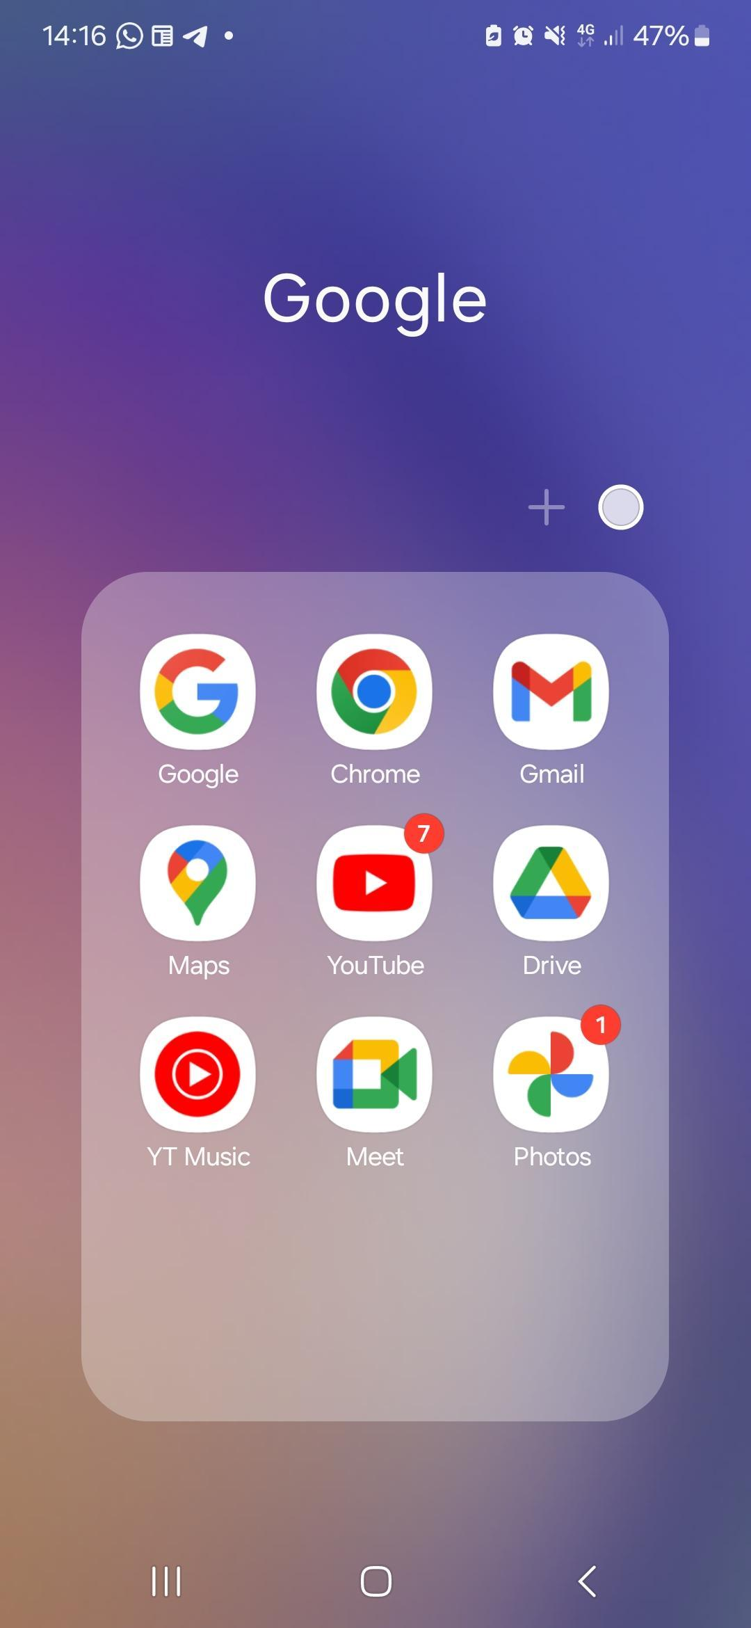
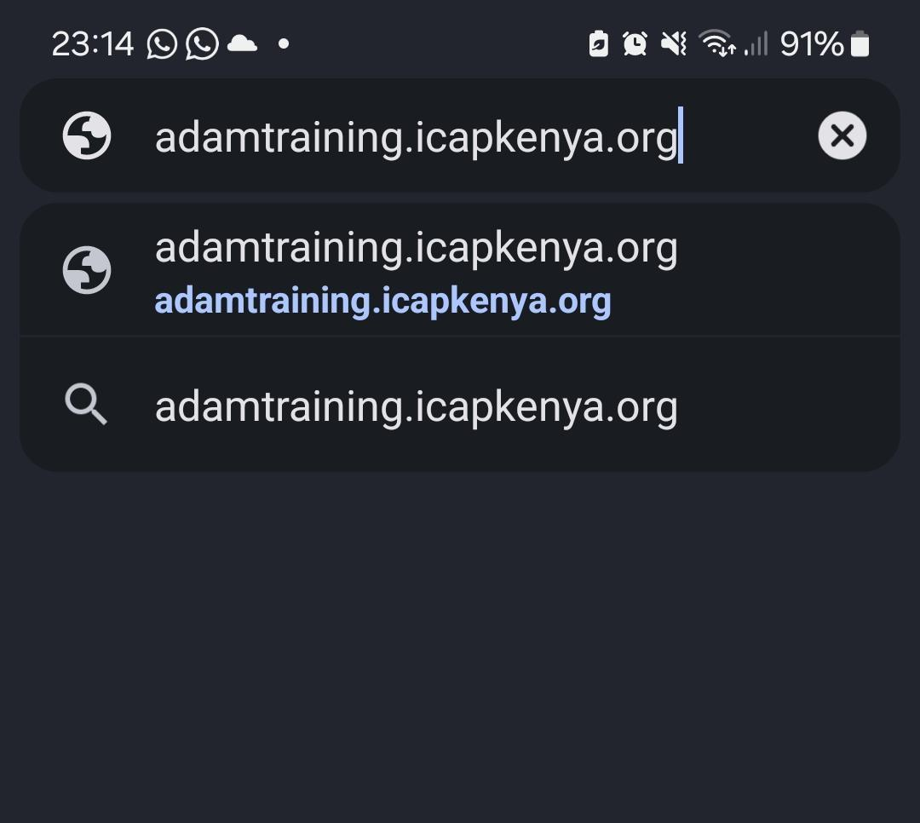
Workflow Guides
Accessing ADAM
Open your phone browser
Navigate to the address bar
Type in the following link adamtraining.icapkenya.org

Slide 18
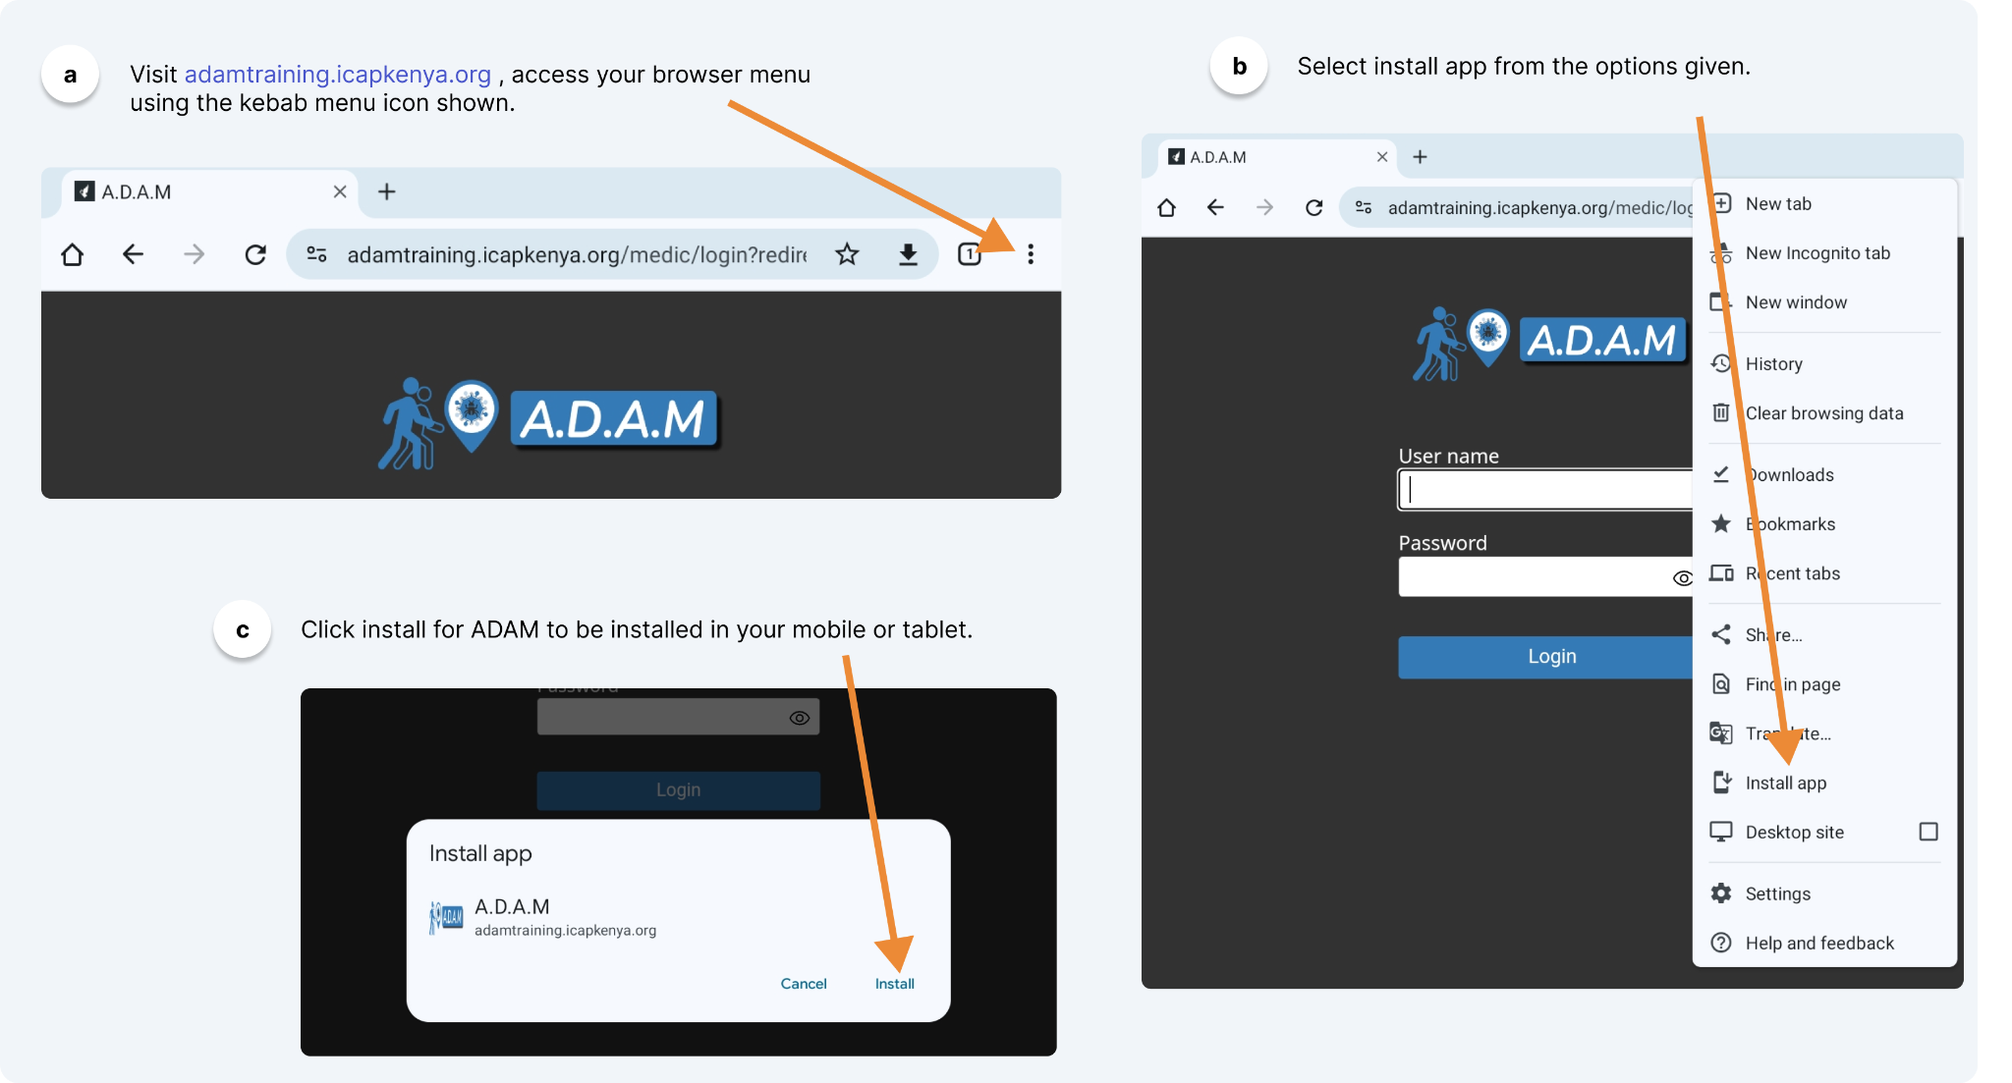
Workflow Guides
Installation

Slide 19
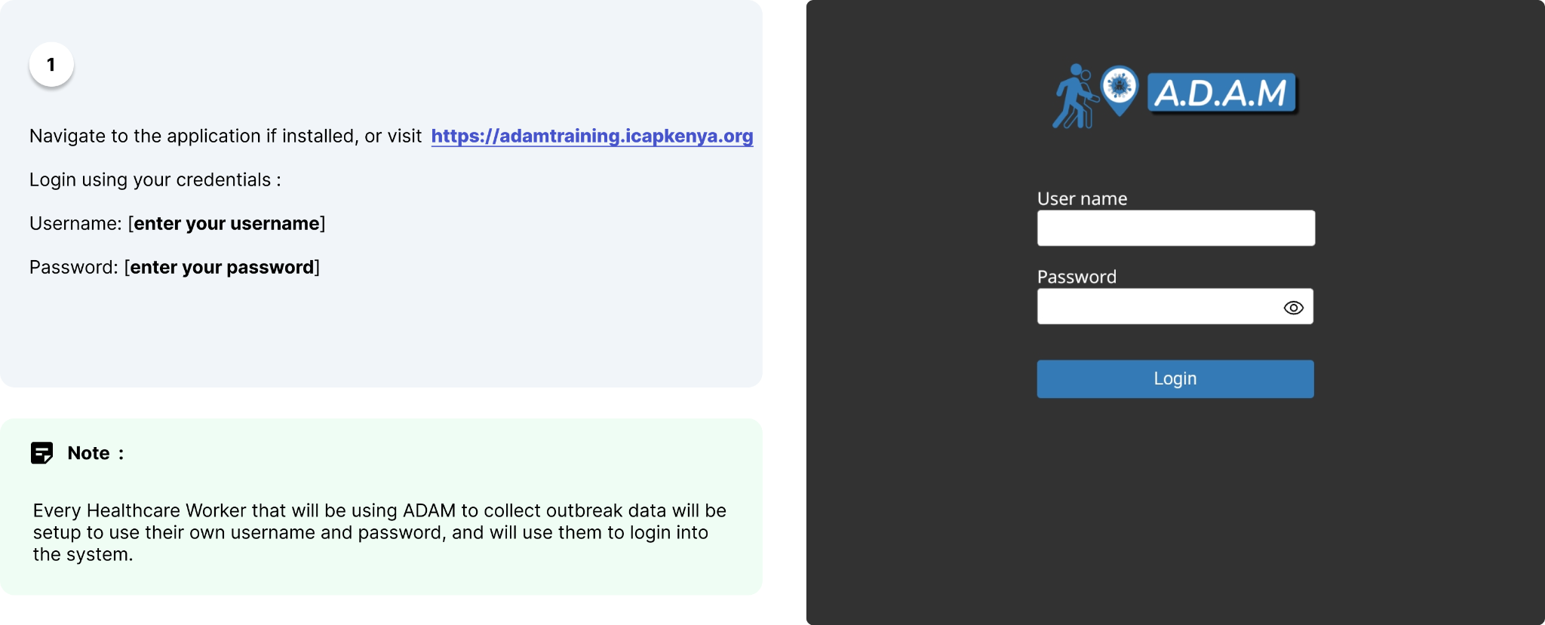
Workflow Guides
Login

Slide 20
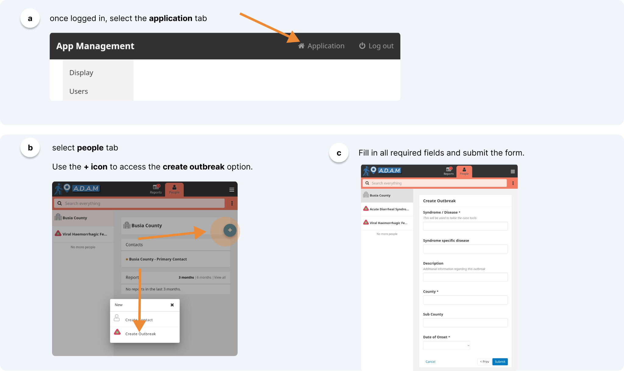
Workflow Guides (Level 1- Administrator)
Outbreak Creation

Slide 21
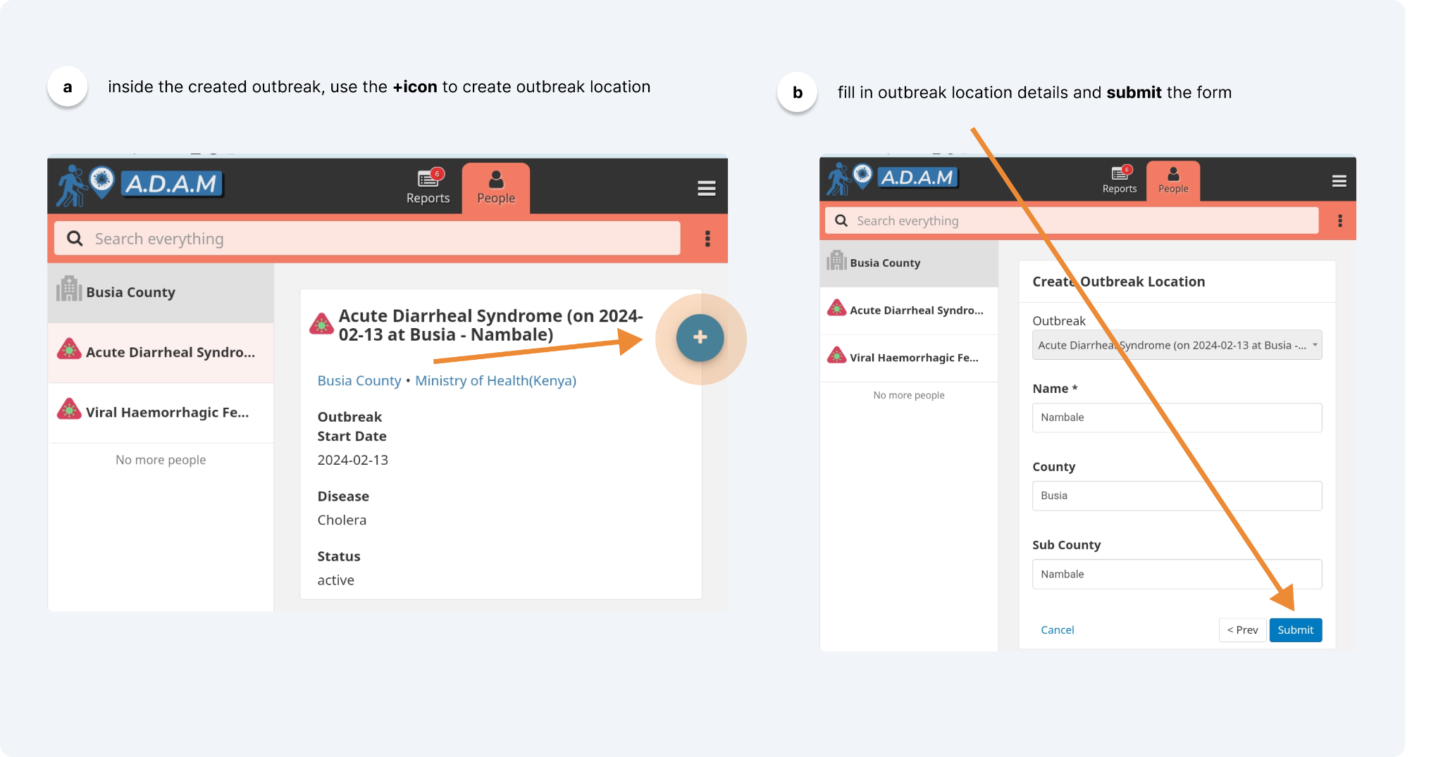
Workflow Guides (Level 1- Administrator)
Creating Outbreak Location

Slide 22
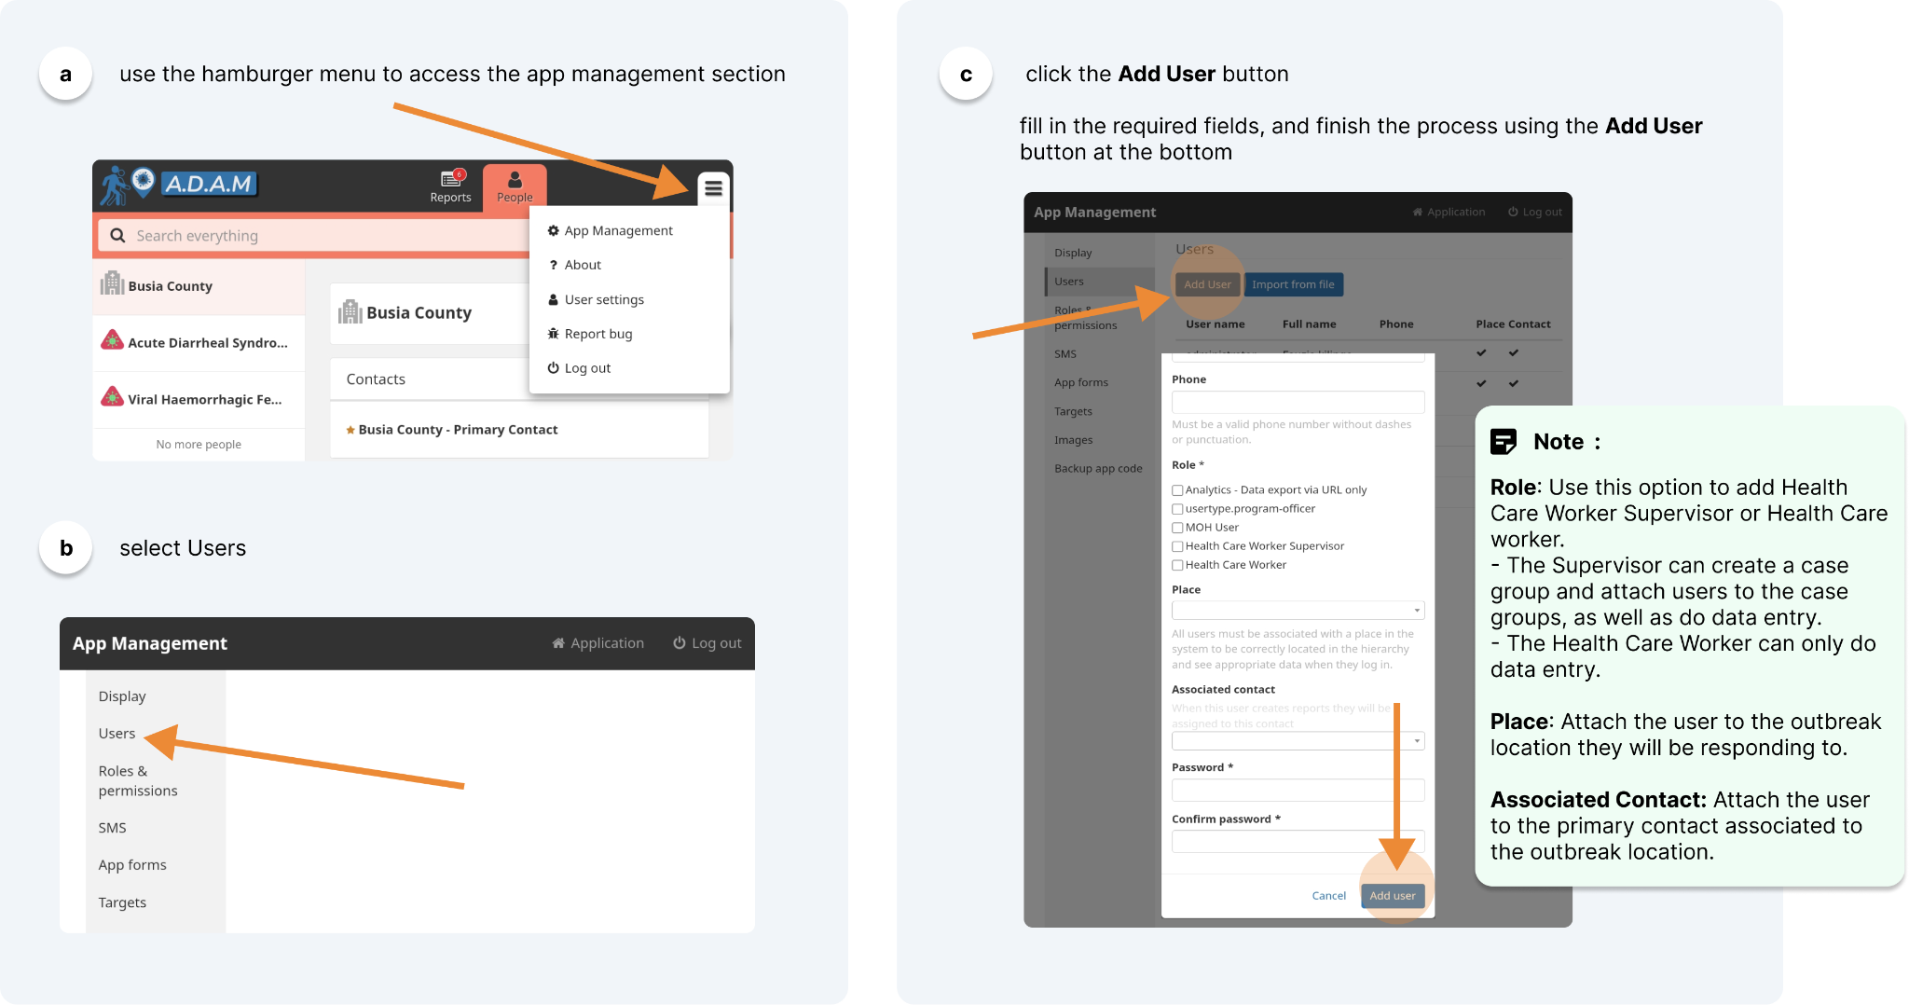
Workflow Guides (Level 1- Administrator)
Adding system users

Slide 23
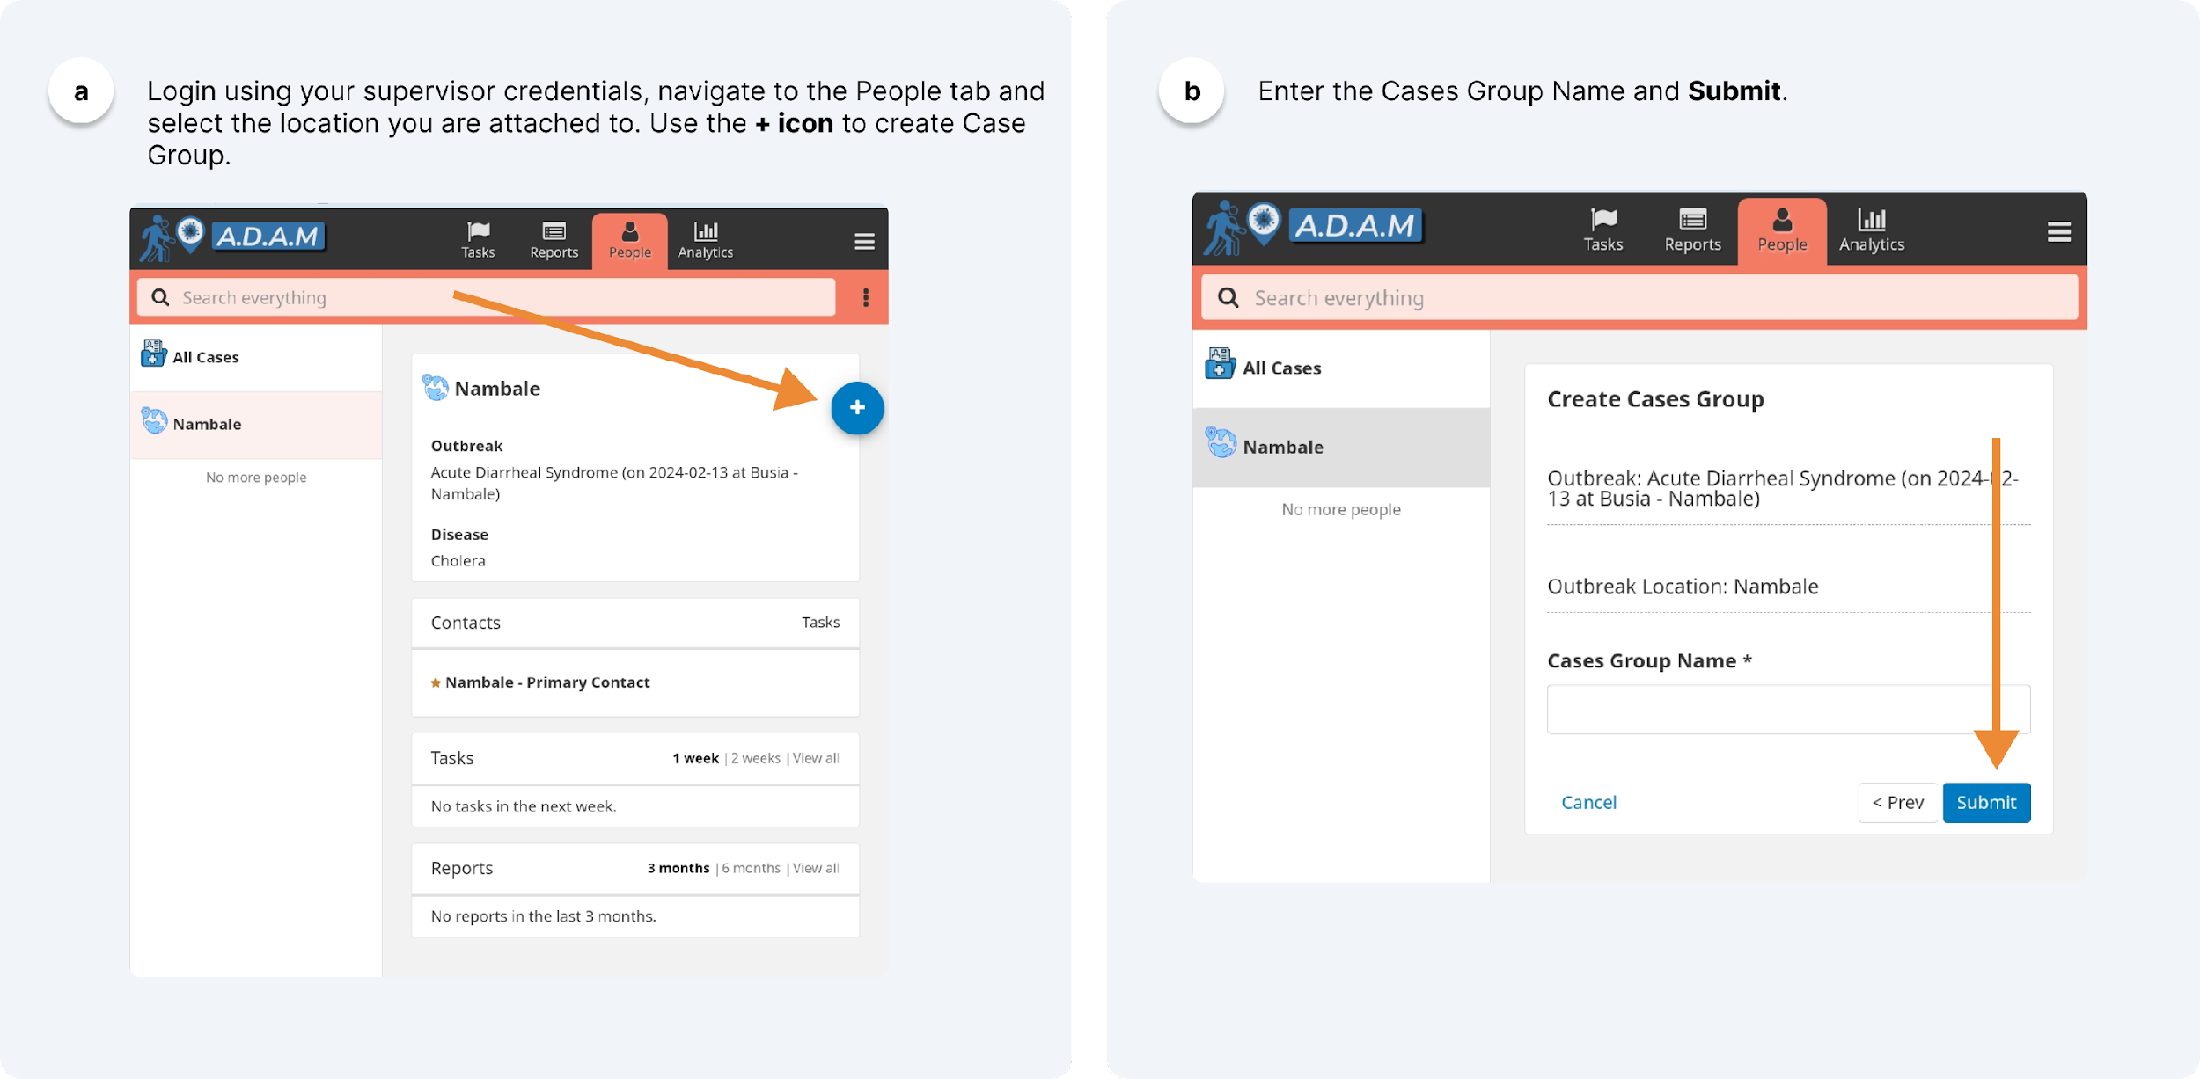
Workflow Guides (Level 2- Supervisor)
Adding system users

Slide 24
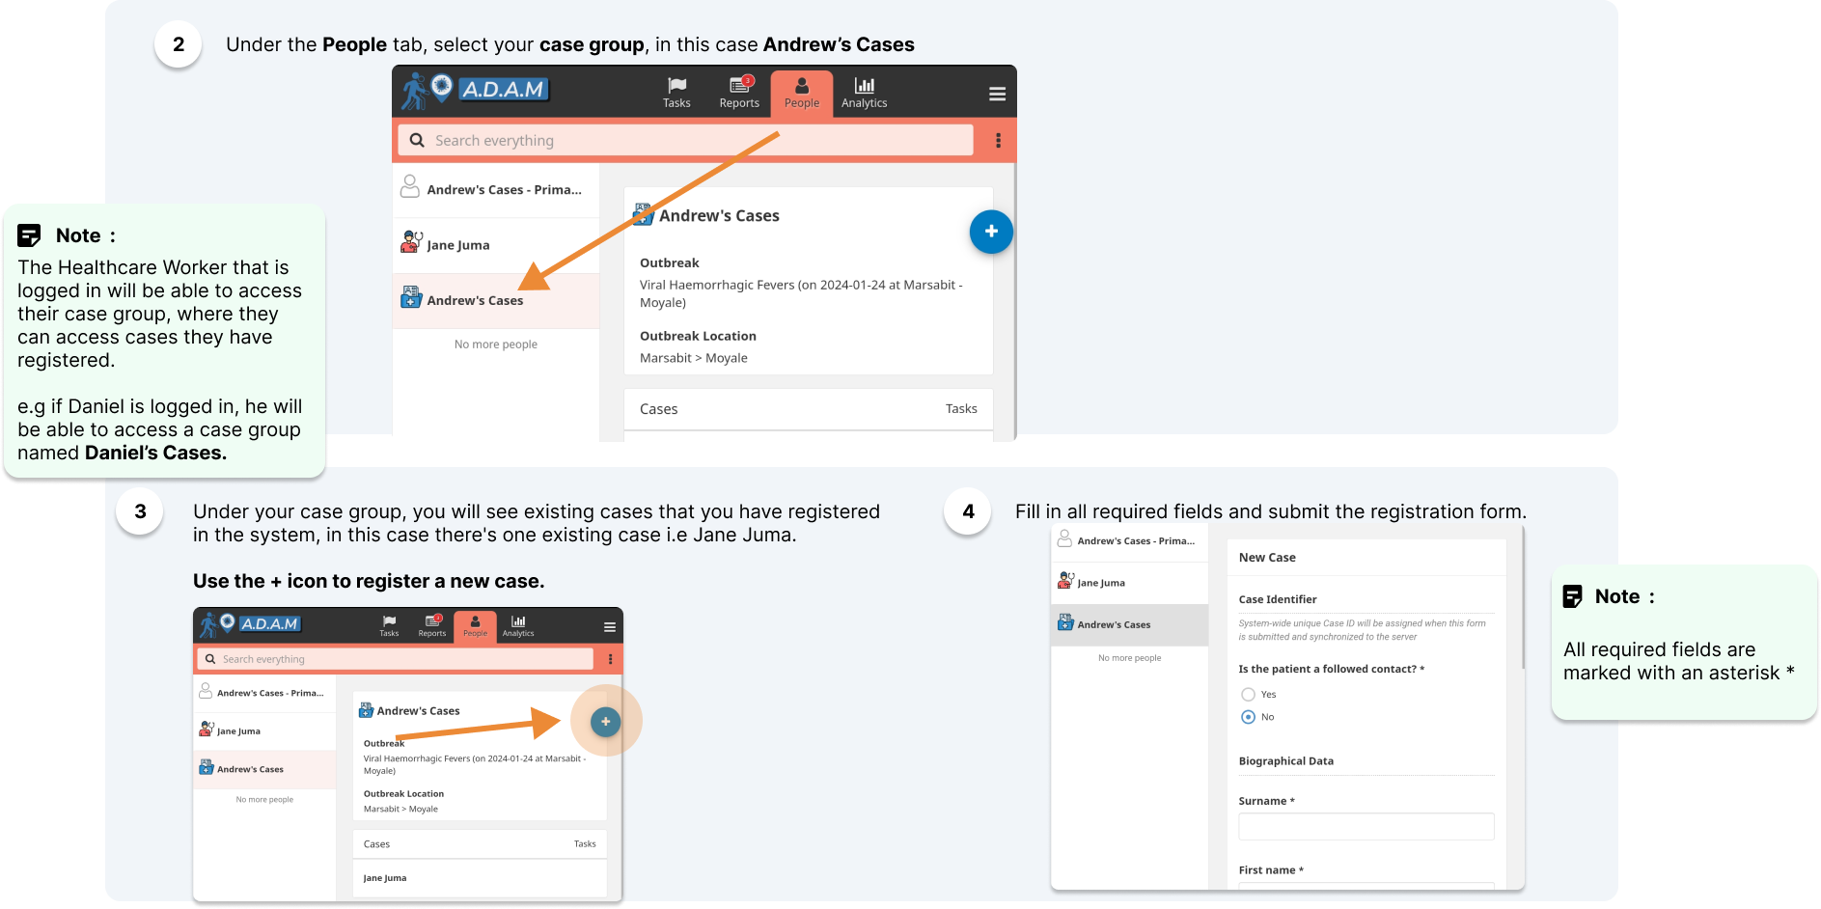
Workflow Guides (Level 2 & 3– Supervisor & Data Entry)
Case Registration

Slide 25
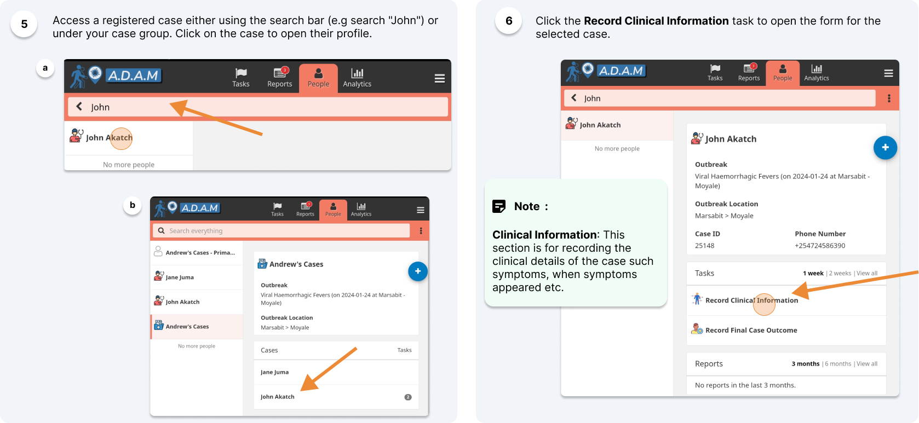
Workflow Guides (Level 2 & 3 – Supervisor & Data Entry)
Record Clinical Information

Slide 26
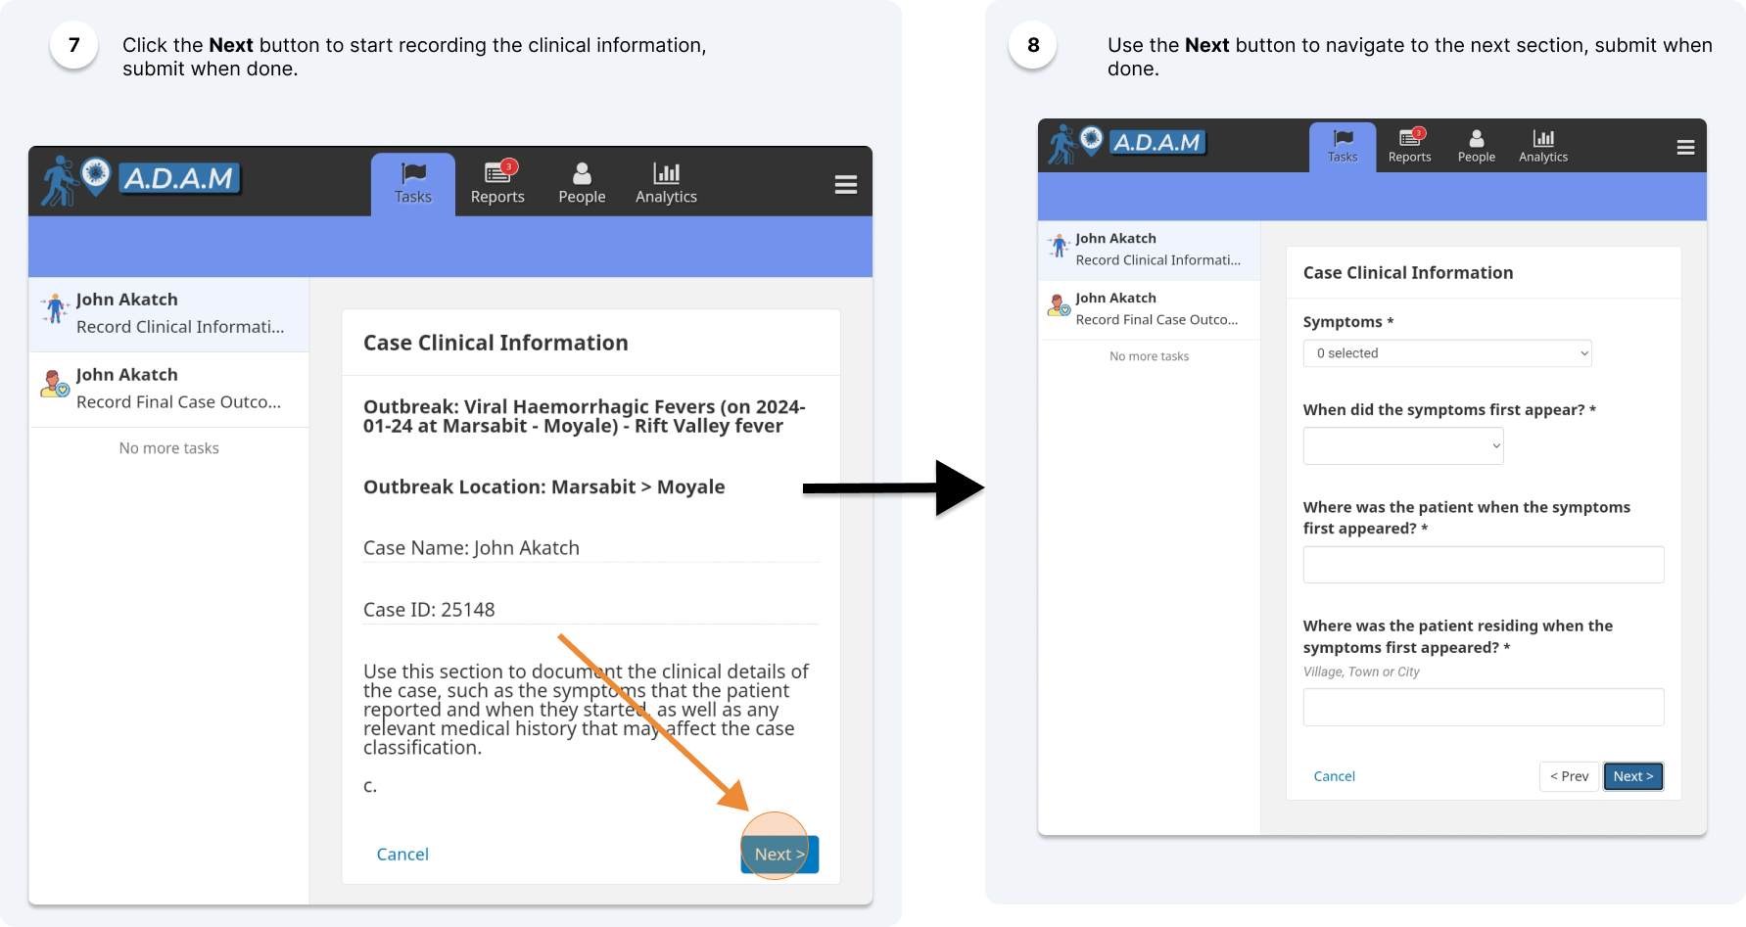
Workflow Guides (Level 2 & 3 – Supervisor & Data Entry)
Record Clinical Information

Slide 27
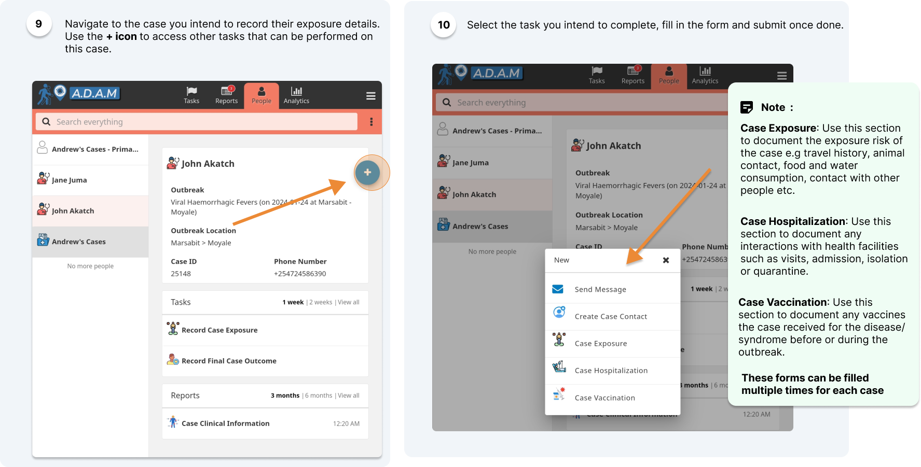
Workflow Guides (Level 2 & 3 – Supervisor & Data Entry)
Case Exposure, Hospitalization, Vaccination & Create Case Contact

Slide 28
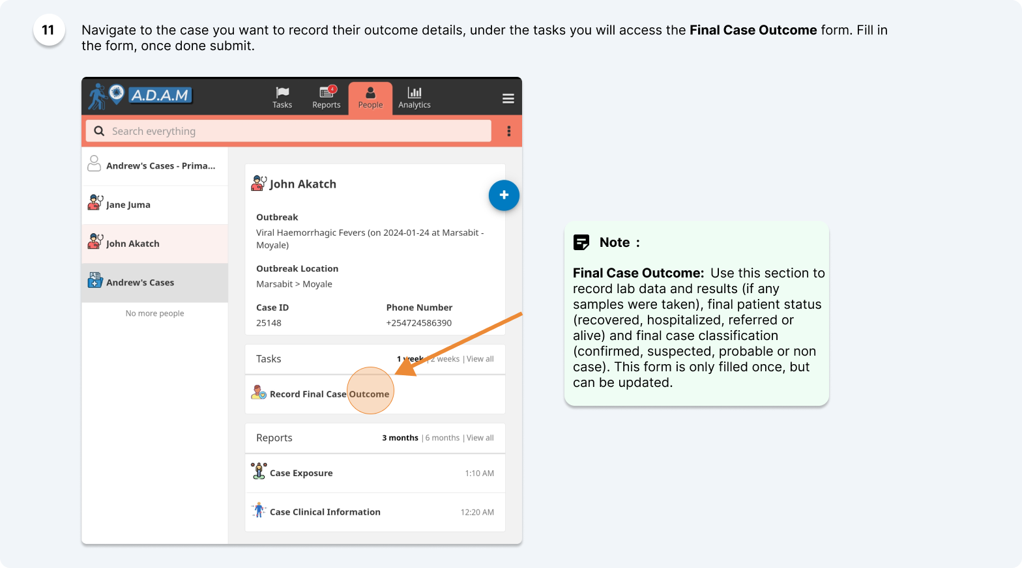
Workflow Guides (Level 2 & 3 – Supervisor & Data Entry)
Final Case Outcome

Slide 29
USE CASE SCENARIOS
Scenario 1 (Outbreak Creation)

Slide 30
THANK YOU

